Slide 1
OPO Theory of Operation

Slide 2
Optical Parametric Oscillator
idler
Pump
NLO Crystal
Signal
Resonator provides feedback at signal or idler or both
No signal beam required as input
Buildup from noise
No population inversion takes place no energy storage
Single pass gain = single pass loss threshold condition

Slide 3
Optical Parametric Process
P=ε₀[χ⁽¹⁾E+χ⁽²⁾E E++χ⁽³⁾E E E+⋅⋅⋅]
Energy conservation
E_{IN} = E_{OUT} = E₁ + E₂
ω_{in} = ω₁ + ω₂
→ Wavelength pairing
λ= wavelength
Momentum conservation
k_{IN} = k₁ + k₂
→ Phase matching
n=index of refraction
Labeling convention !
for λ_{in} < λ₁ < λ₂
in = Pump, 1 = Signal, 2 = Idler
Pump
Idler
Param.
Process
χ⁽²⁾
Signal
P= Polarization
E= Electrical Field
χ= optical susceptibility
()= Order

Slide 4
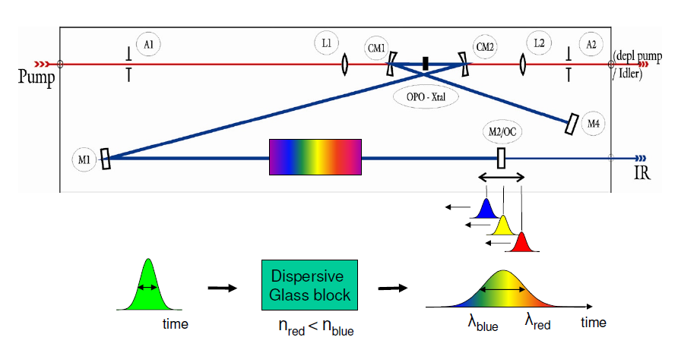
Tuning Methods of OPOs – II
Tuning Methods: pump tuning
dispersion tuning
OPO with bulk KTP
pump tuning curve
OPO with PP crystal
dispersion tuning

Slide 5
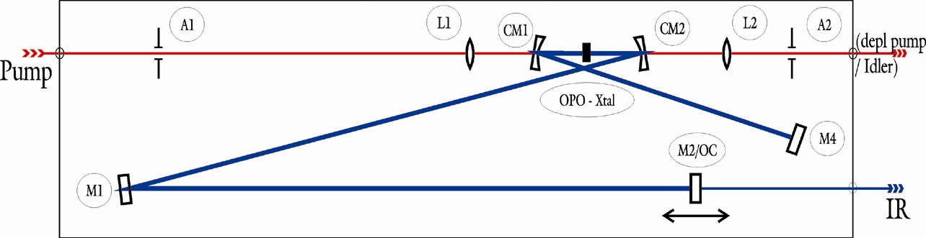
Dispersion Tuning – PP OPO
Dispersive
Glass block
time
n_{red} < n_{blue}
λ_{blue}
λ_{red}
time

Slide 6
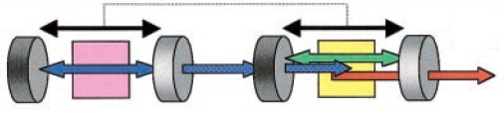
Synchronously Pumped Ultrafast OPOs
Synchronously pumped OPO
the length of the OPO is matched to
that of the pump laser resonator
T_{LASER}
l_{OPO}
The gain experienced in one pass will be enhanced by
the gain experienced on the subsequent passes
The consecutive coincidence of the parametric and pump wave
amplifies the signal until it overcomes the threshold

Slide 7
Femtosecond OPO Schematics
Pricipal OPO scheme
Low pulse energy → pump beam focussing
80 MHz → 1.875 m cavity length
OPO
Lens
ω₀ = 50 µm
80 MHz
1.875 m

Slide 8
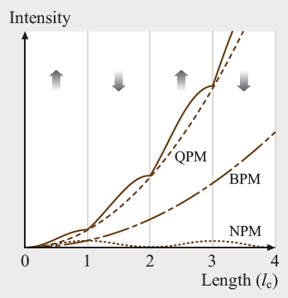
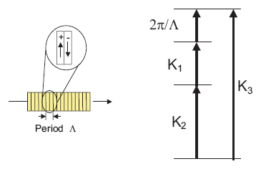
Quasi-Phase-Matching
QPM- Quasi-Phase Matching
Advantage: higher non linearity, broader phase-matching range
BPM- Birefringence Phase Matching
NPM- None Phase Matching
Experience back conversion no growth
Periodic change in the sign of the nonlinear susceptibility before the back conversion starts.
The field will be enhanced instead of cancelling during the second half of the cycle

Slide 9
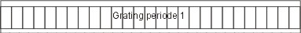
Periodically-Poled OPO Crystal
Quasi Phase Matching:
(Momentum conservation)
: Grating period
PP-Xtals
Extremly broad phasematching range
Fixed pump wavelength (comfortable)
PC controlled OPO tuning
→ Dispersion tuning λ_{Signal} ~ L_{Cavity}

Slide 10
PP Fan Crystal
Crystal structure
Position of
pump beam
Translation of the crystal leads to continuous poling periode change
Selection of the proper poling periode for each pump / Signal wavelength combination
λ_{Signal}
λ_{Idler}
1600
1500
1400
Λ
1300
OPO Signal wavelength / nm
1200
1100
1000
900
750
770
790
810
830
850
Pump wavelength / nm

Slide 11
PP Fan Crystal
The fan poled crystal: phase-matching
Example poling periods of a PP MgO:LN crystal for different pump / Signal combinations

Slide 12


